Slide 1
Moseq Report
Mohan Yang

Slide 2
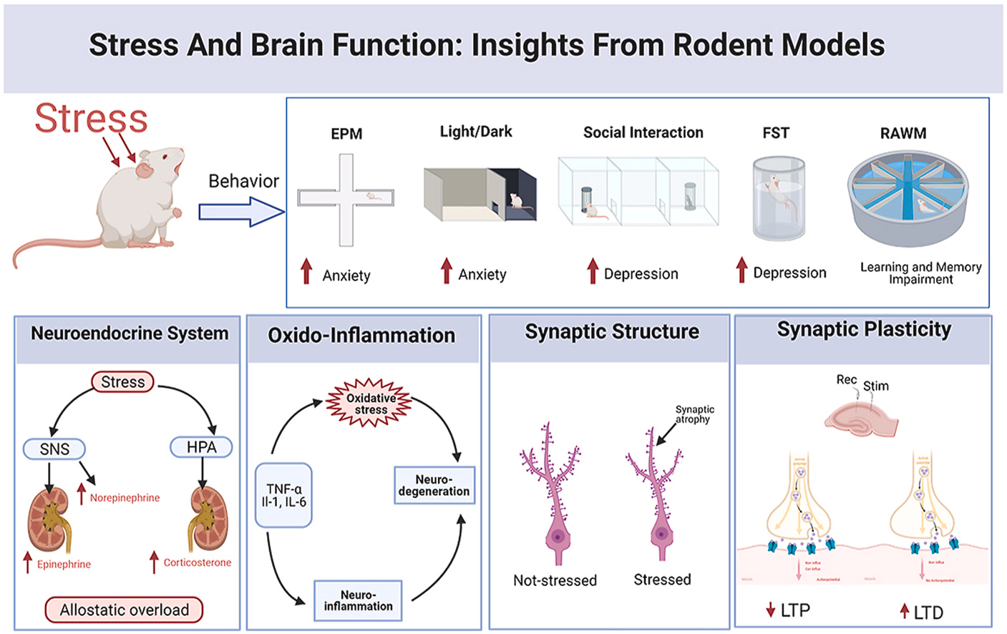
Background
Chronic stress is a major risk factor for many neuropsychiatric disorders, and its effects on behavior are complex and difficult to quantify
Traditional behavioral assays capture limited aspects of changes, therefore subtle but meaningful behavioral alterations go undetected
Computational technology such as motion sequencing enables more detailed behavioral analysis, helping us to further understand how chronic stress affects behavioral processes

Slide 3
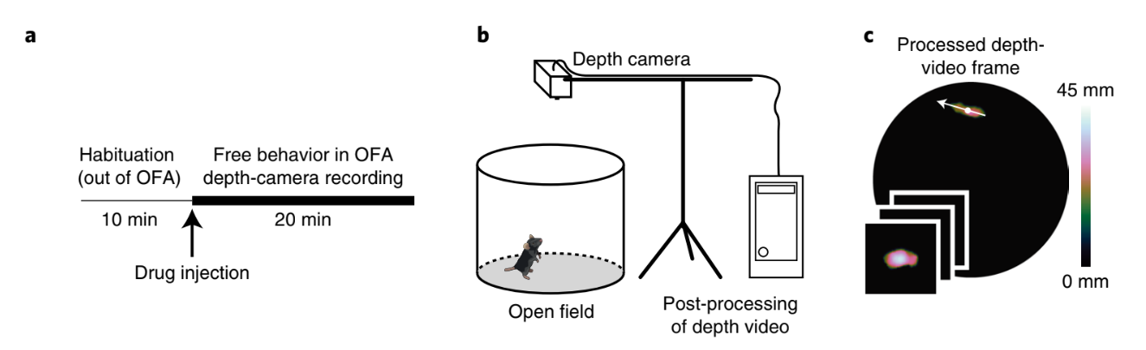
Motion Sequencing
Motion sequencing (MoSeq) identifies sub-second behavioral “syllables” in an unsupervised, data-driven way, providing a detailed and unbiased map of how animals organize their movements over time
MoSeq captures changes in the frequency, duration, and transitions between behavioral motifs
These fine-scale insights are valuable for studying anxiety- and depression-like states, which makes Mo-seq useful

Slide 4
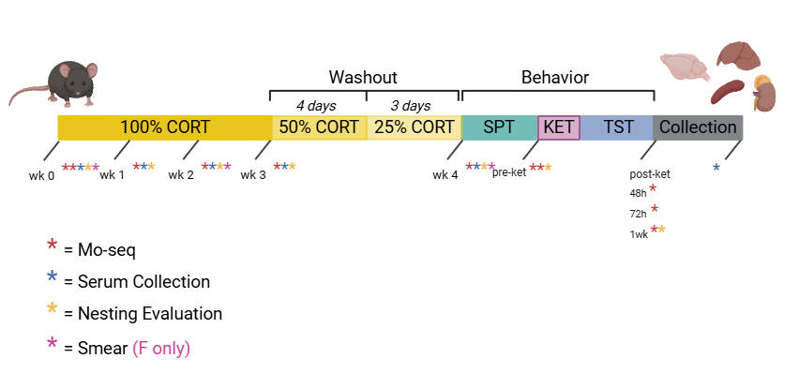
Experiment Timeline

Slide 5
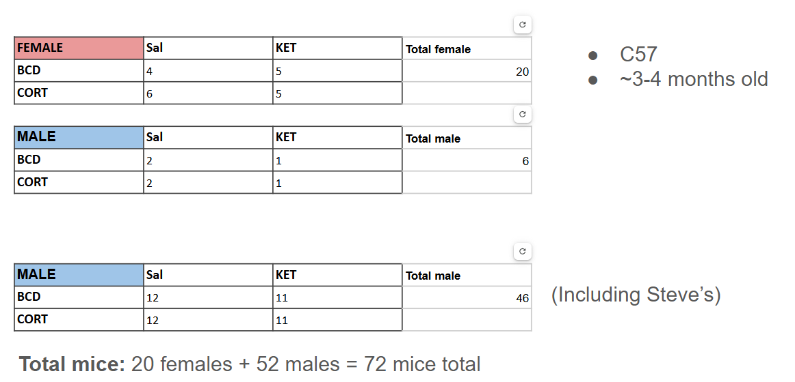
Sample Size

Slide 6
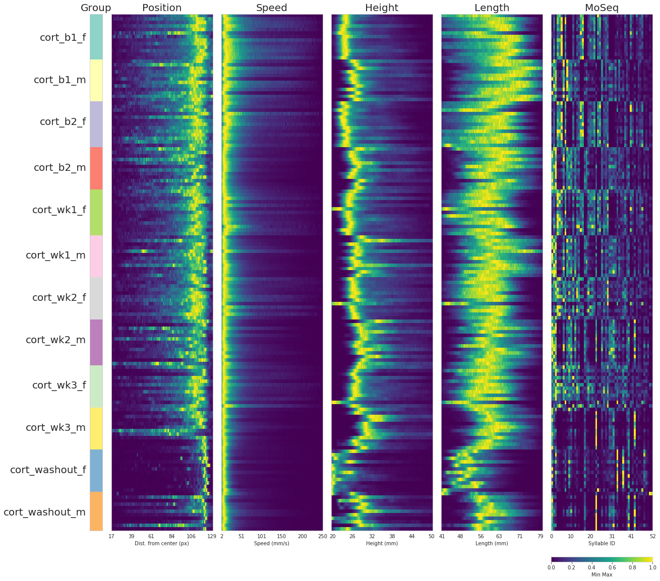
Finger Print Plot:
Male mice’s speeds tends be slower than the female mice.
Male mice has higher height and length than female mice
Moseq syllable distribution is different between male and female

Slide 7
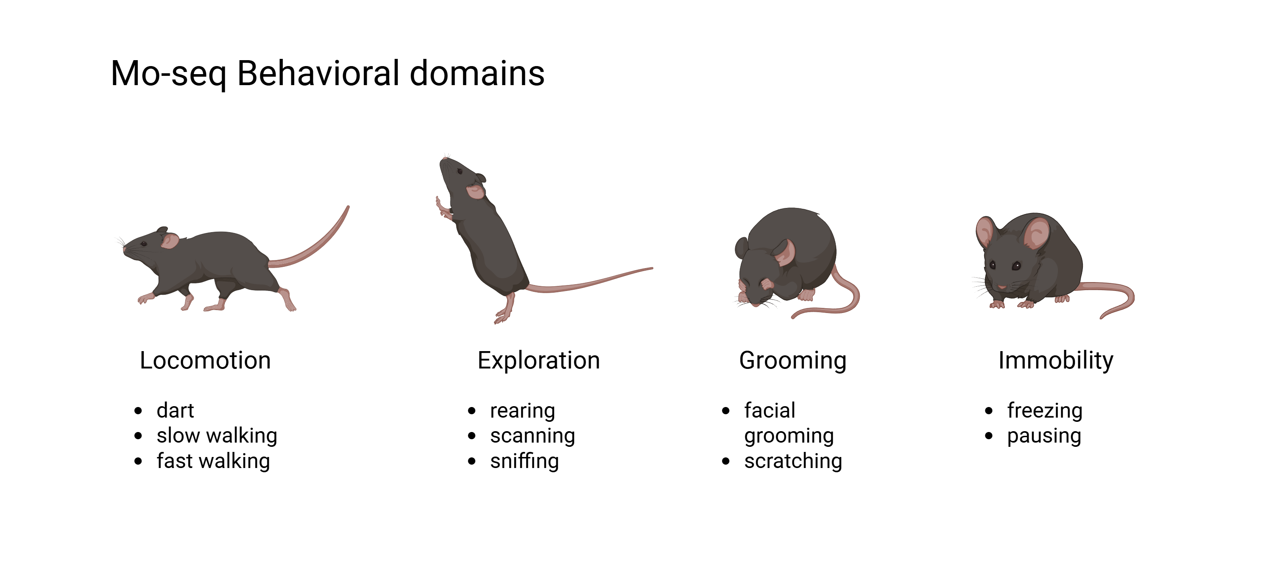

Slide 8
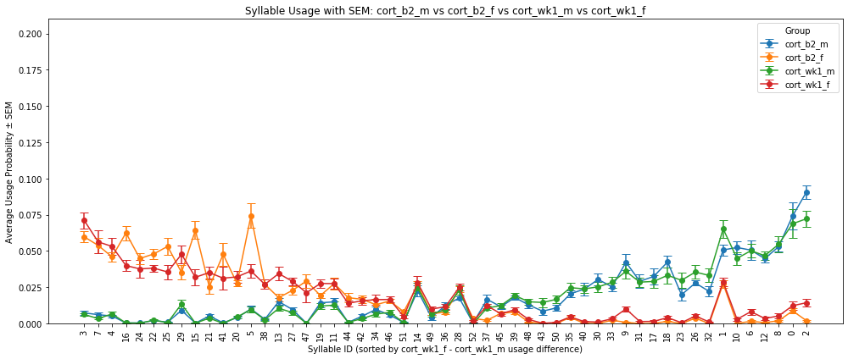
Male and Female Baseline Difference in Syllable Distribution

Slide 9
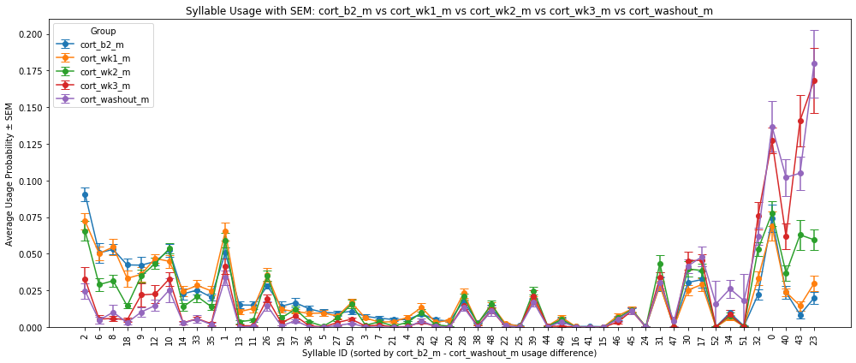
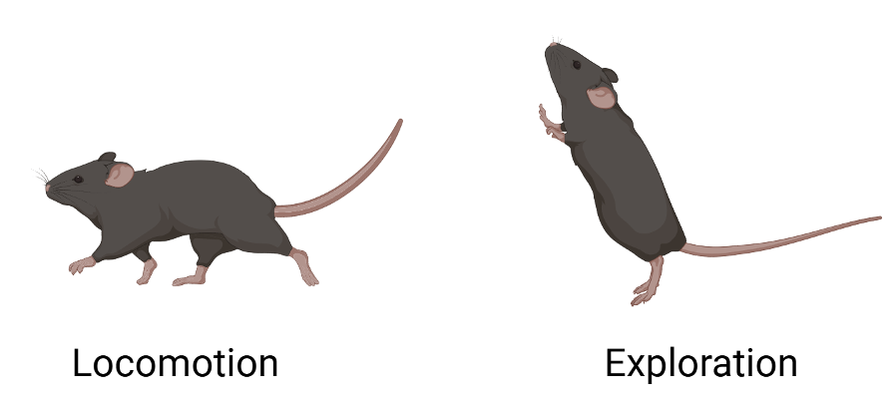
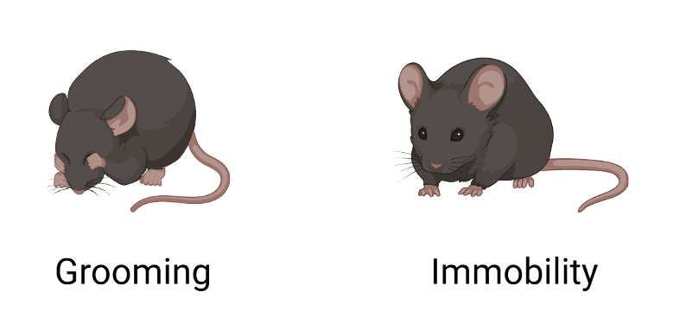
Cort Male Group comparison over time

Slide 10
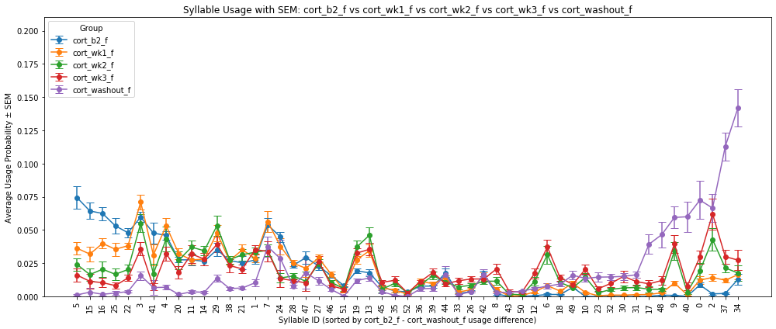
Cort Female Group comparison over time

Slide 11
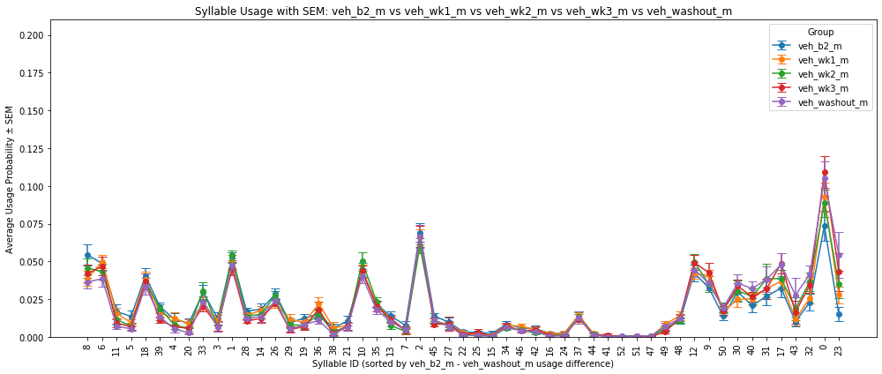
Vehicle Male Group comparison over time

Slide 12
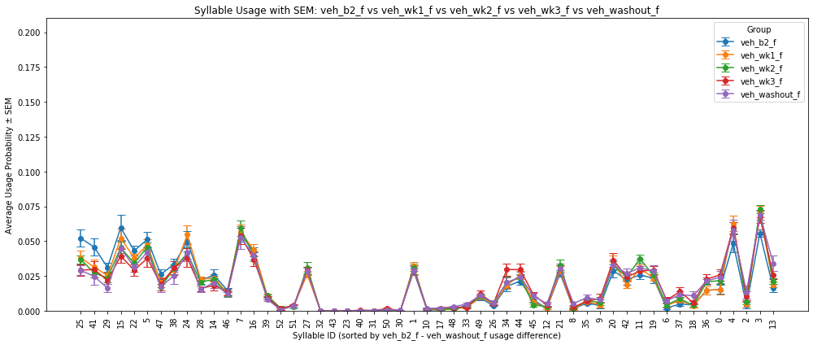
Vehicle Female Group comparison over time

Slide 13
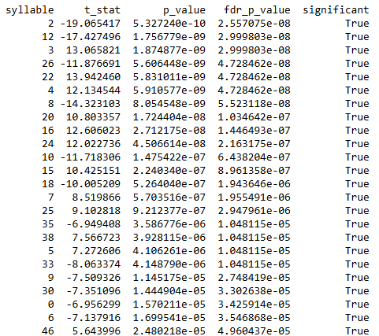
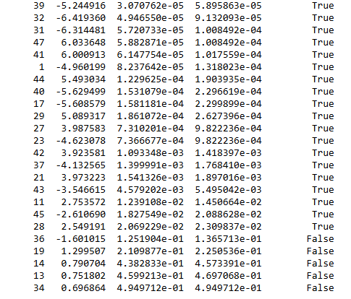
Cort Baseline female vs. male t-test

Slide 14
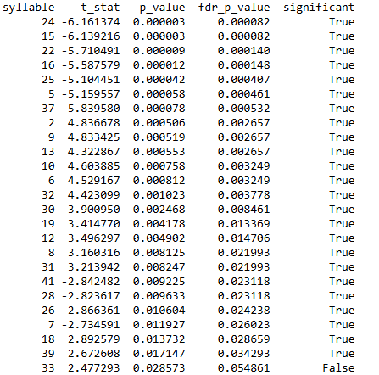
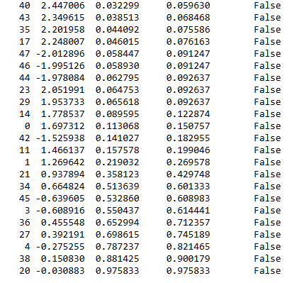
Cort week2 female vs. Cort baseline female t-test

Slide 15
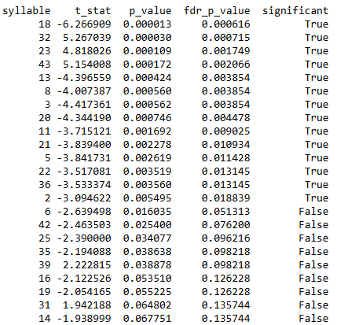
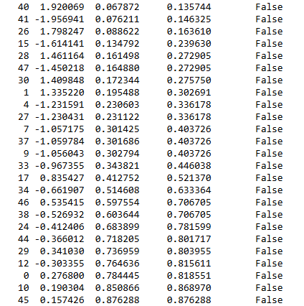
Cort week2 male vs. Cort baseline male t-test

Slide 16
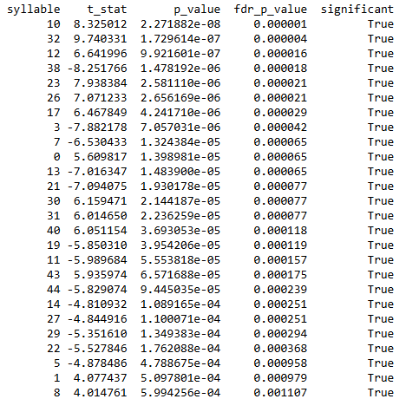
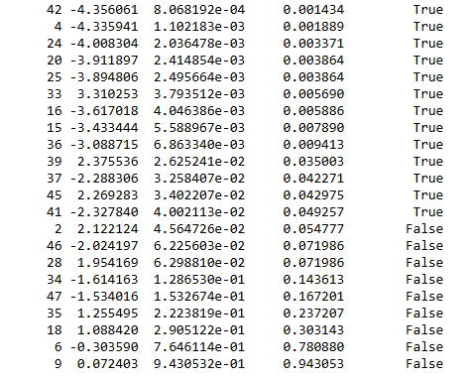
Cort wk2 female vs. male t-test

Slide 17
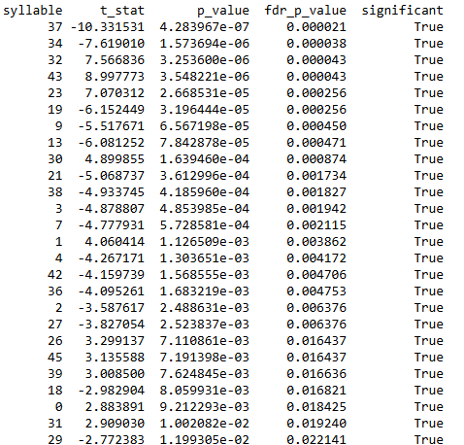
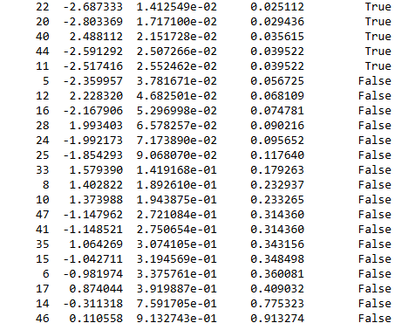
Cort washout female vs. male t-test

Slide 18
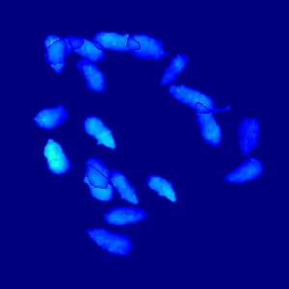
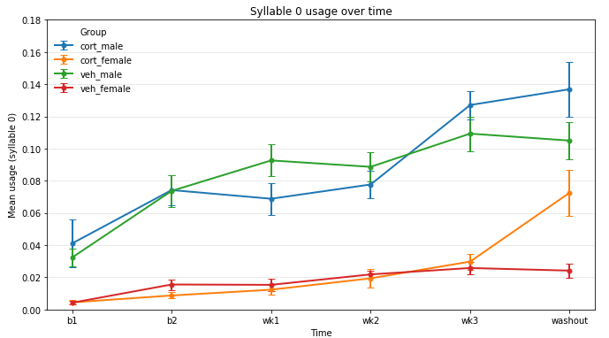
Syllable 0: Staying Still (Immobility)
Across Female and Male Cort Baselines, Male mice stays still more than Female mice
During cort, immobility behavior increases faster in the Cort treatment group

Slide 19

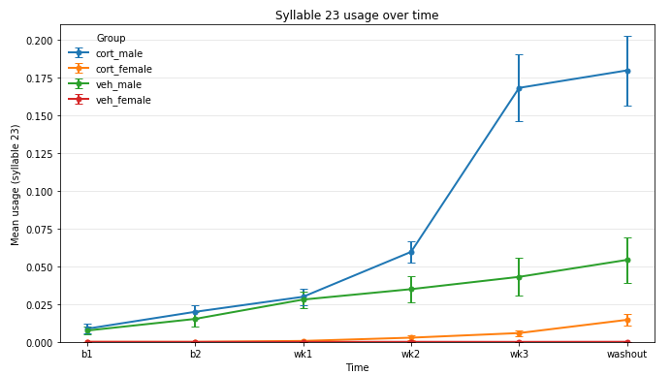
Syllable 23: Grooming
During cort, grooming behavior increases more in male mice.

Slide 20

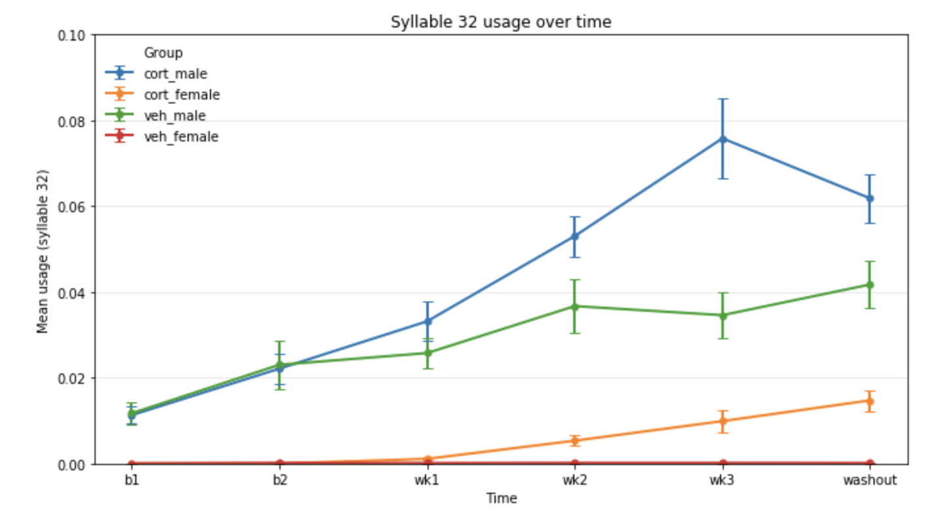
Syllable 32: Grooming
Both male and female mice increases grooming behavior during cort treatment

Slide 21
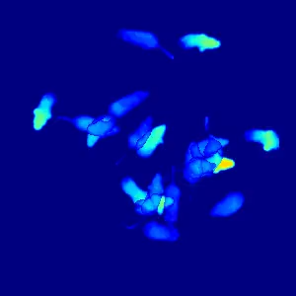
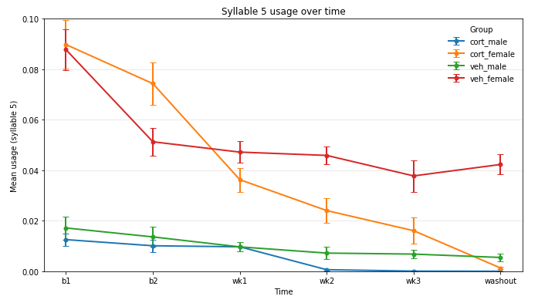
Syllable 5: Dart (locomotion)
In the baseline, female mice darts more than the male mice, and as Cort treatment progresses, darting behavior decreases in both female and male group.

Slide 22
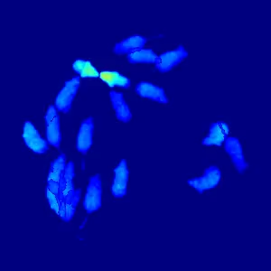
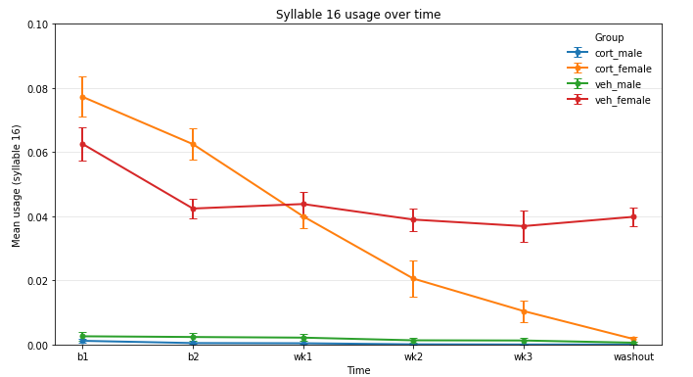
Syllable 16: running forward (locomotion)
Male mice is lacking this syllable usage. Forward movement for male is captured in syllable 8.
During cort, this behavior decreases almost to 0 in female mice.

Slide 23
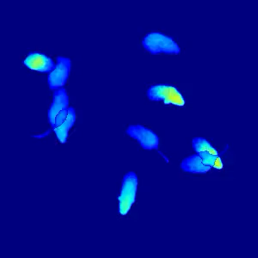
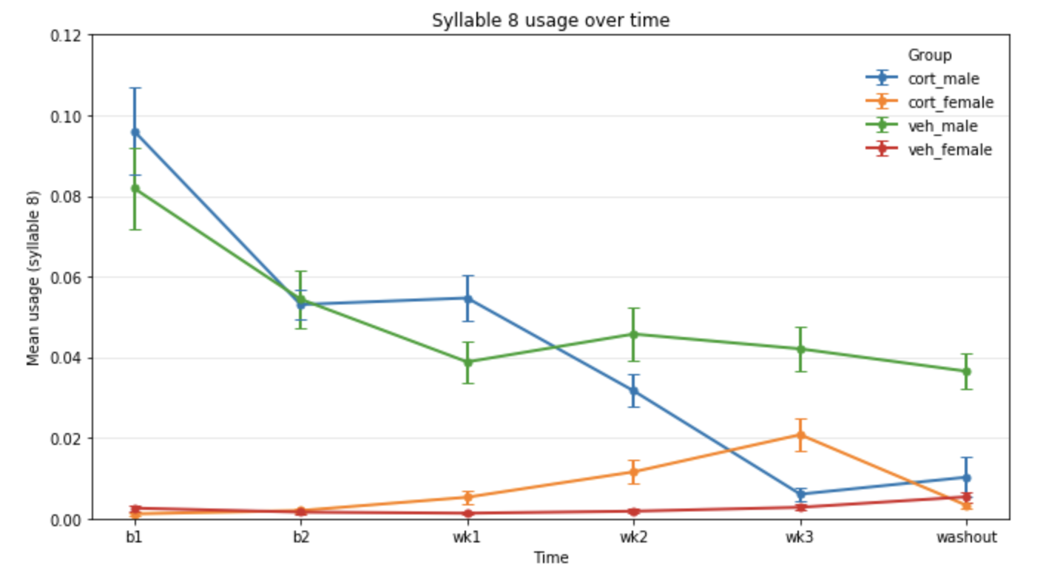
Syllable 8: Moving forward (locomotion)
Male mice has less locomotion during cort treatment.

Slide 24
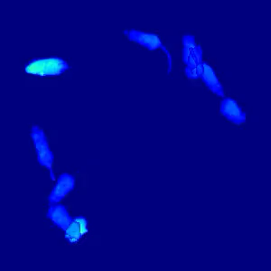
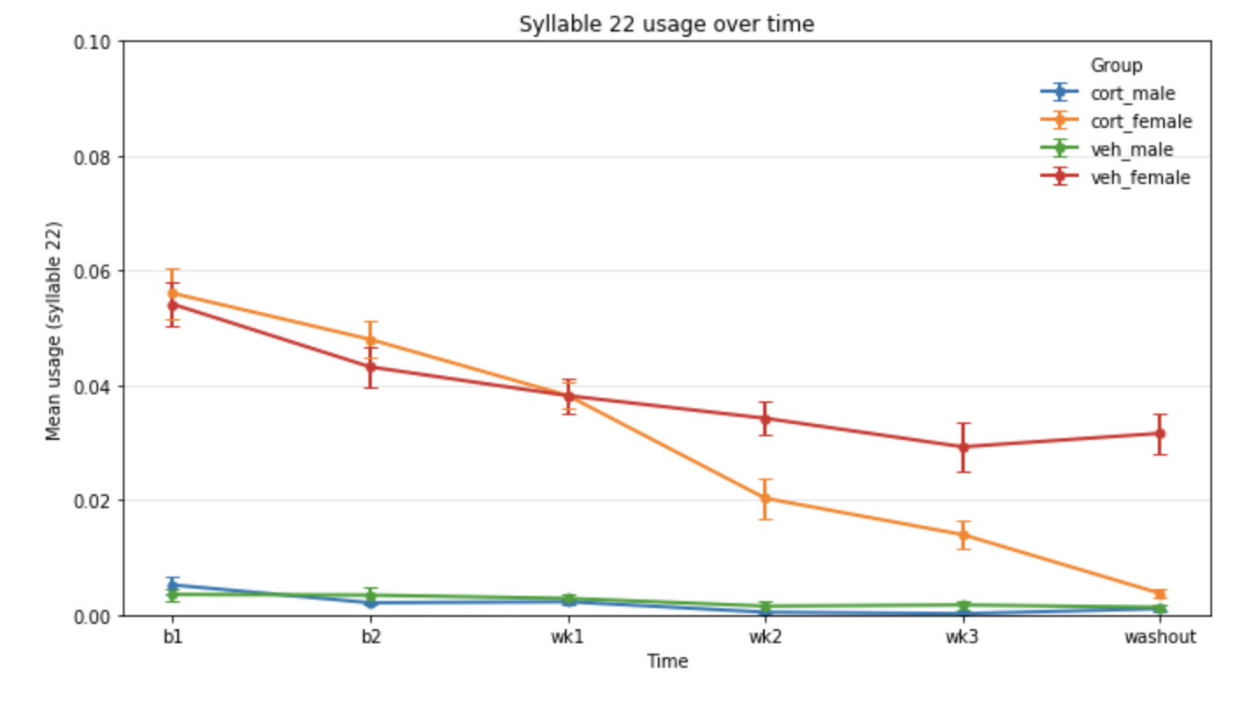
Syllable 22: rearing (Exploration)
Male mice is lacking this syllable behavior, male rearing is captured in syllable 26/33/35
During Cort, female mice decreases rearing behavior

Slide 25
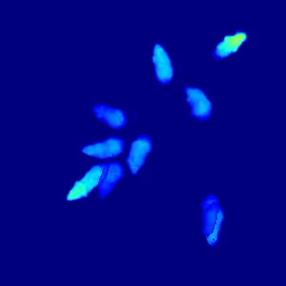
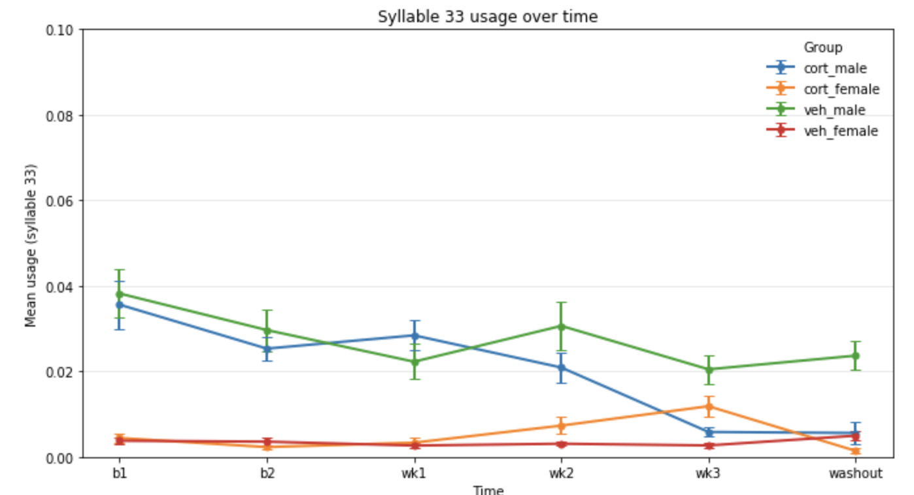
Syllable 33: rearing (Exploration)
Female is lacking this rearing syllable.
During cort, male mice decreases rearing

Slide 26
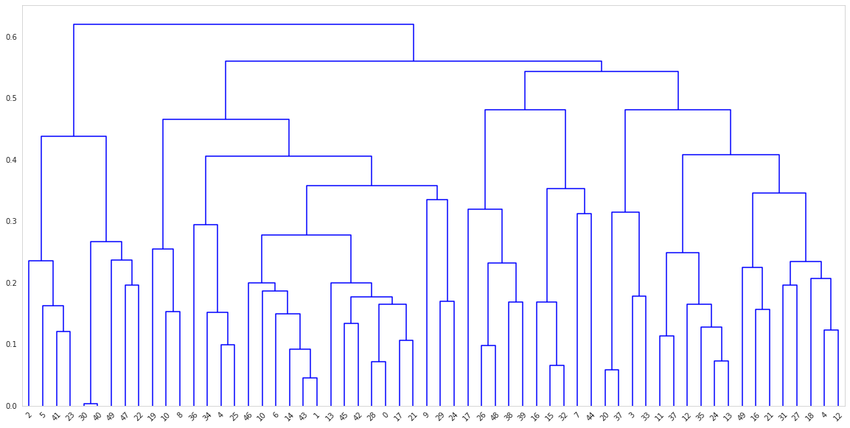
Dendrogram (arinit-average)

Slide 27
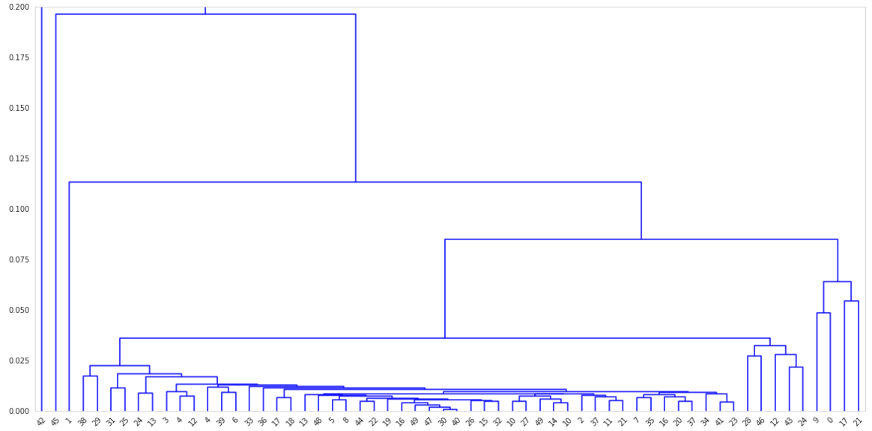
Dendrogram (ardtw-average)

Slide 28
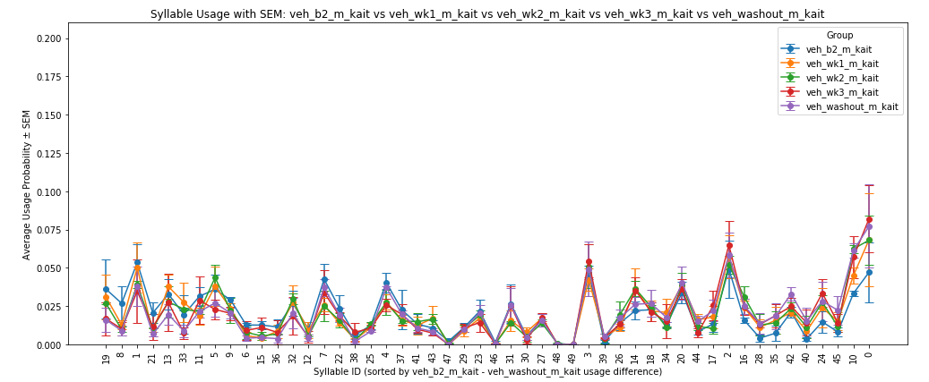
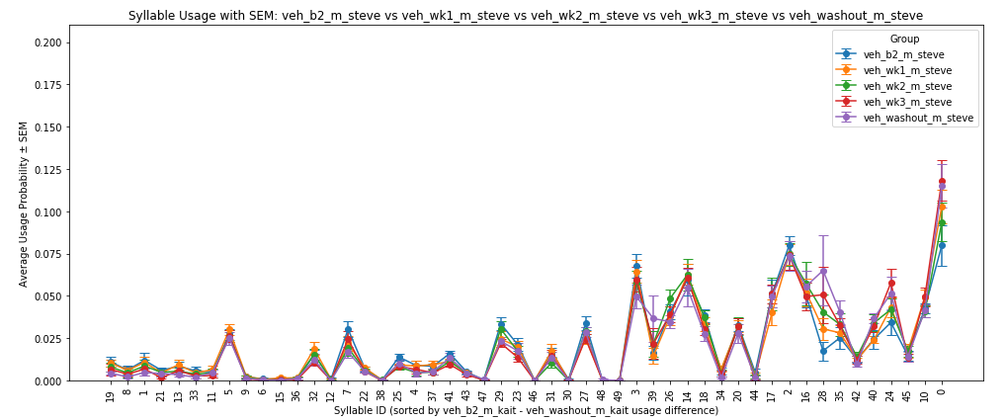
Kaitlyn’s veh data vs.
Steve’s veh data

Slide 29
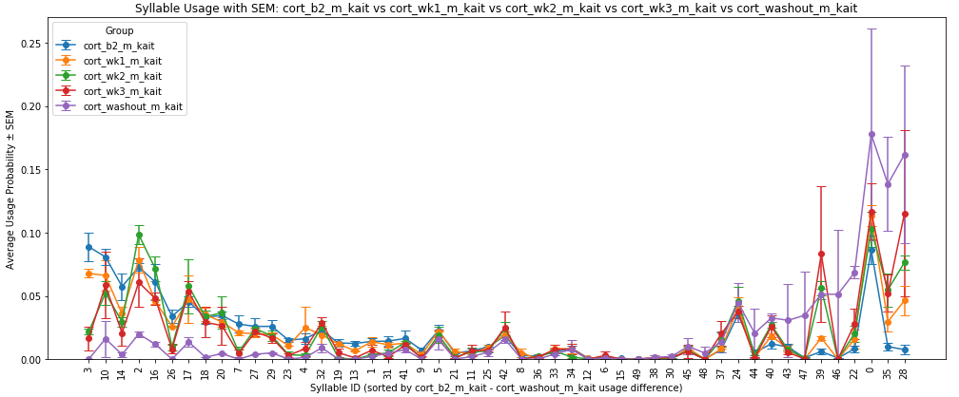
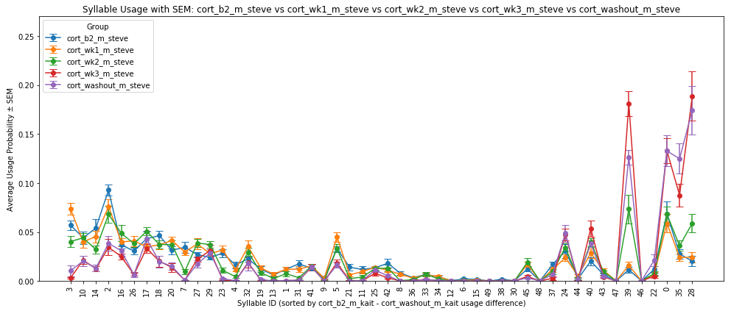
Kaitlyn’s cort data vs.
Steve’s cort data

Slide 30
Findings:
For locomotion and rearing, males and females tend to use non-overlapping syllables for the same behavioral category (Syllable 16 vs. 8 for forward movement; Syllable 22 vs. 33 for rearing)
This likely reflects subtle sex differences in movement kinematics that MoSeq captures automatically.
 | Males | Females
Immobility | High baseline immobility, increase with cort | Low baseline immobility, increase with cort
locomotion | darting and walking foward decreases during cort | both dart and run decreases sharply during cort
exploratory | Rearing decreases during cort | Rearing decreases during cort
grooming | Increase with cort, males tends to increase grooming behavior more than female | Increase with cort

Slide 31
Discussions:
There are important sex differences in both baseline behavior and responses to chronic stress, emphasizing the need to include both males and females in neuropsychiatric research
Stress-induced behavioral changes may be sex-specific, which has important implications for understanding and developing targeted treatments for anxiety and depression
Anxiety- and depression-like phenotypes can be detected even during natural, free behavior, supporting a shift toward less invasive, more ethologically relevant approaches for studying psychiatric-like states in animal models

